Slide 1
CSE 4451
HUMAN-COMPUTER INTERACTION
Novia Nurain email: novia@cse.uiu.ac.bd

Slide 2
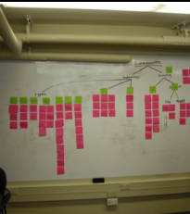
Today’s Agenda
Introductions
Course introduction
Group formation

Slide 3

Introductions
Introduce yourself
Share a fun fact about yourself

Slide 4

About course
Marks distribution
Attendance: 10
Class Test: 10
Project milestone updates: 20
Mid: 25
Final Project: 35

Slide 5

About course
Communication
For class-related questions (Lectures, Assignments, Projects), we prefer to communicate via Slack
Please join the slack
Section A: HCI/D_fall23_secA
Section B: HCI/D_fall23_secB
https://join.slack.com/t/hcidfall23seca/signup
https://join.slack.com/t/hcidfall23secb/signup

Slide 6
Introduction to HCI/d

Slide 7
What is human-computer interaction?

Slide 8

Notes:
a smartphone, tablet, computer, laptop, remote control, coffee machine, ticket machine, printer, GPS, e-reader, smart TV, alarm clock, electric toothbrush, watch, radio, bathroom scales, fitness tracker, game console…
Which ones are easy, effortless, and enjoyable to use?
iPad is a joy to use, where tapping an app and flicking through photos is simple, smooth, and enjoyable. Others, like a ticket machine that does not recognize your credit card after completing a number of steps and then makes you start all over again can be very frustrating.

Slide 9
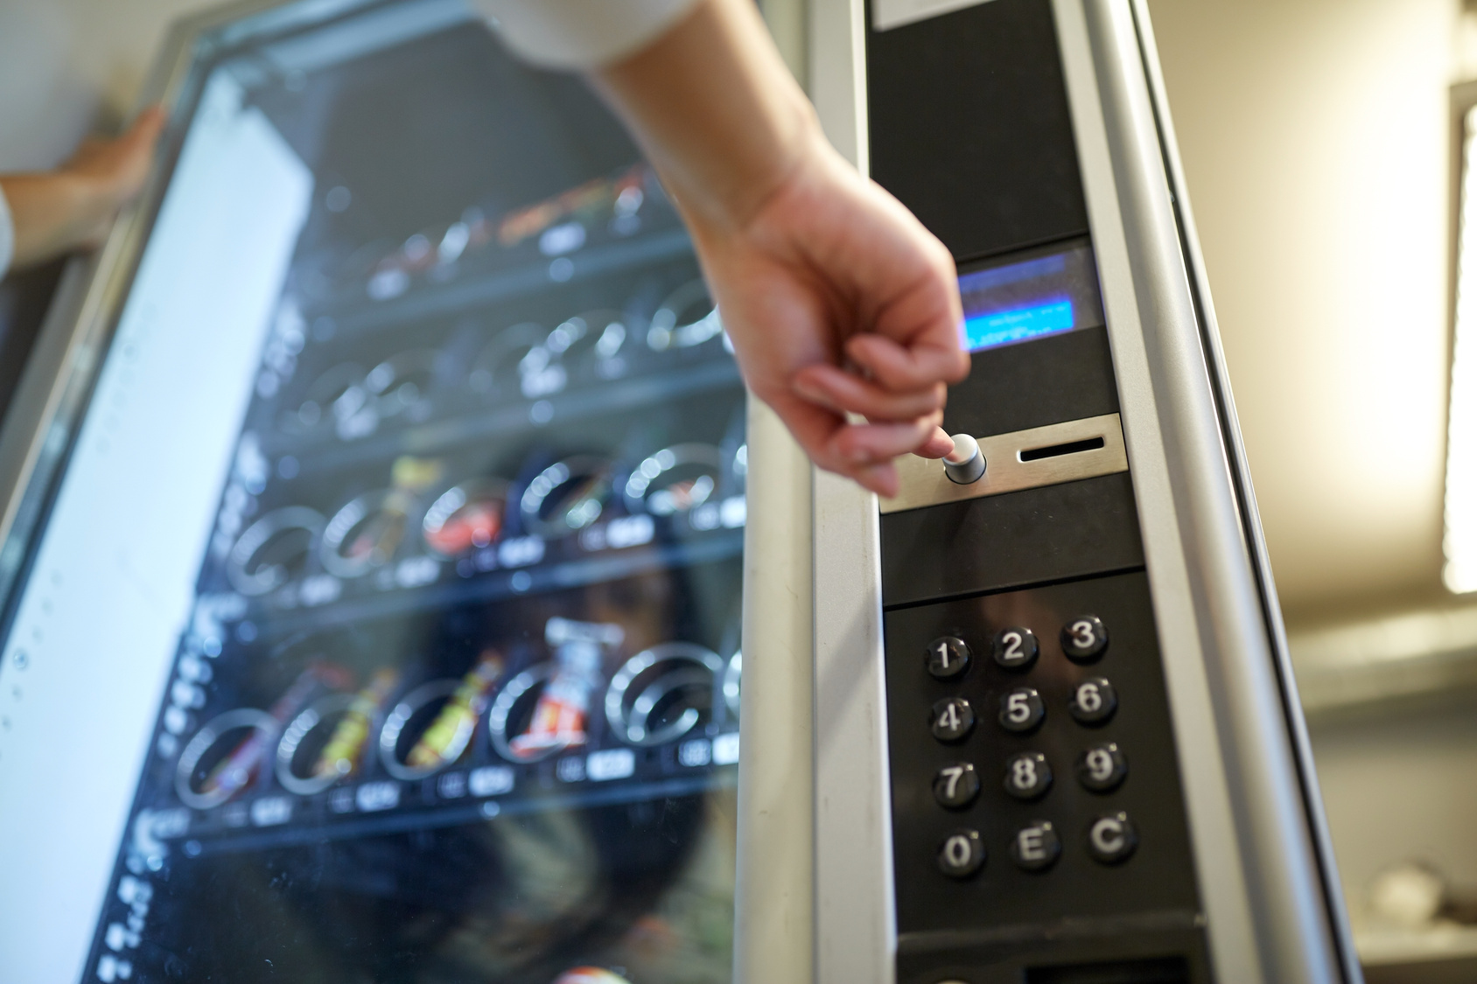

Notes:
a smartphone, tablet, computer, laptop, remote control, coffee machine, ticket machine, printer, GPS, e-reader, smart TV, alarm clock, electric toothbrush, watch, radio, bathroom scales, fitness tracker, game console…
Which ones are easy, effortless, and enjoyable to use?
iPad is a joy to use, where tapping an app and flicking through photos is simple, smooth, and enjoyable. Others, like a ticket machine that does not recognize your credit card after completing a number of steps and then makes you start all over again can be very frustrating.

Slide 10
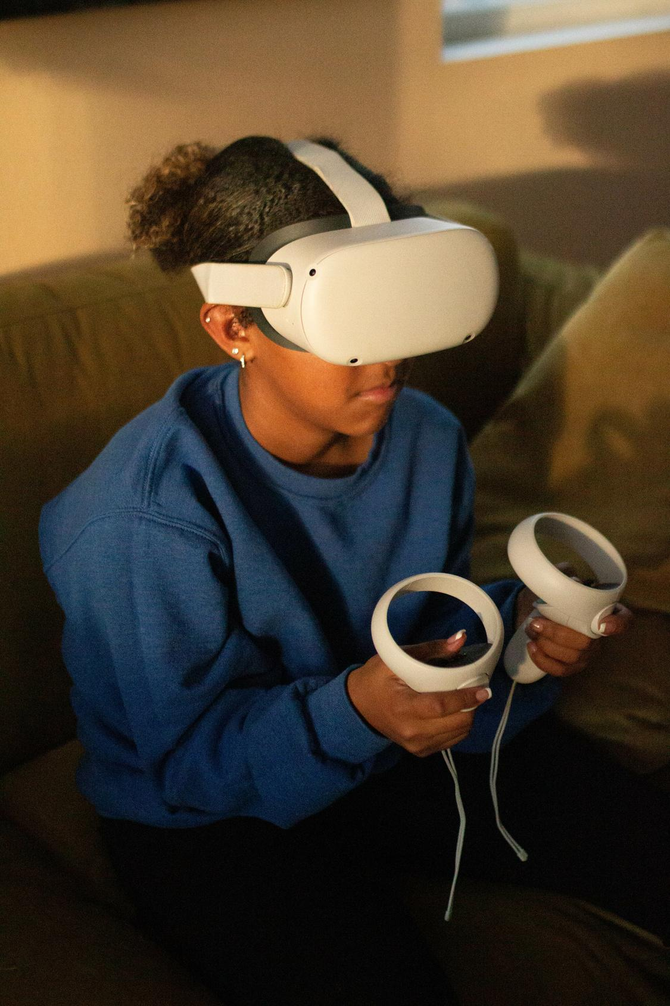
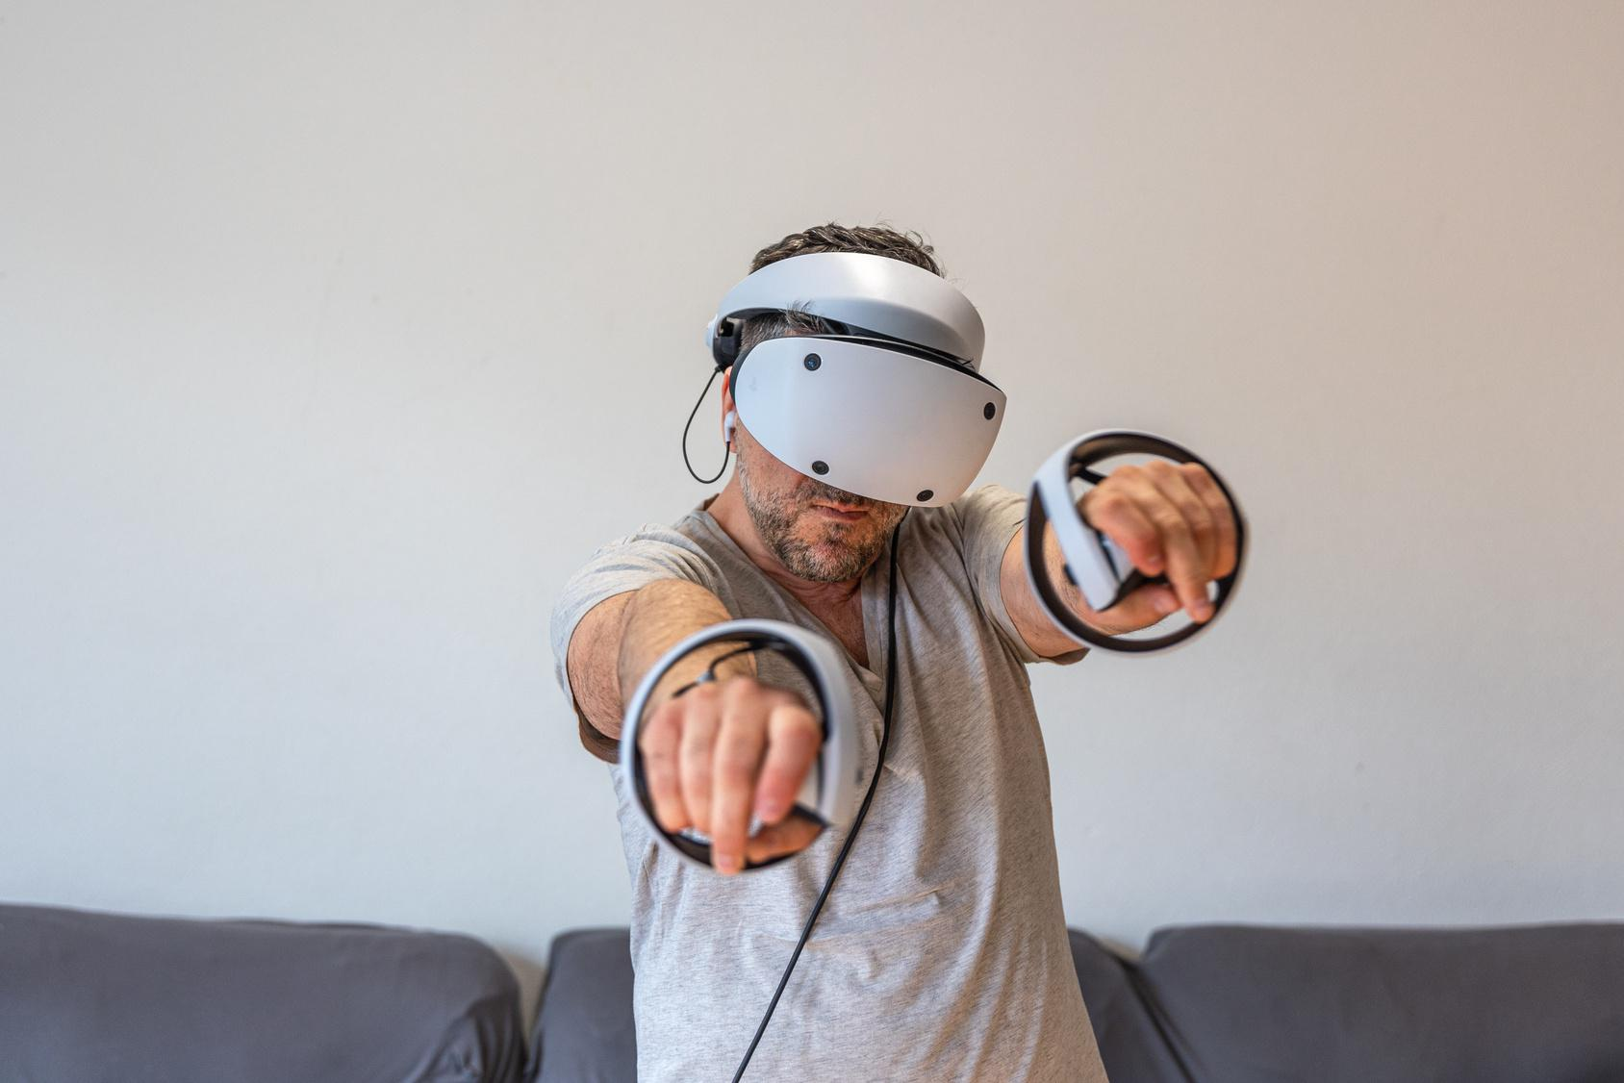
VR Headsets
Notes:
The xbox kinect made playing physical games a physical endeavor

Slide 11
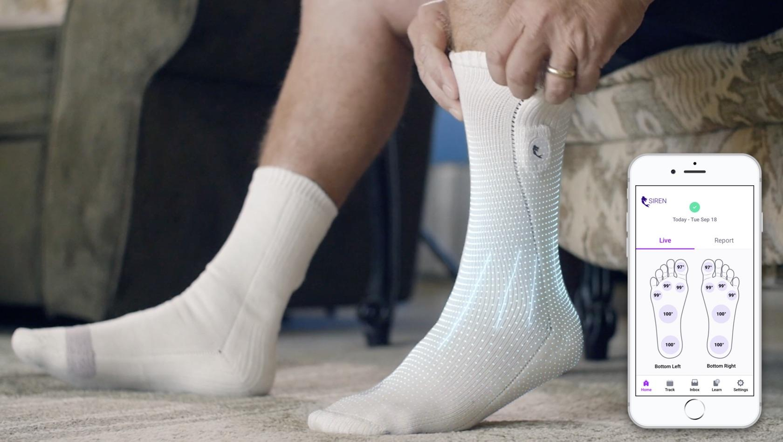
Siren Diabetic Sock and Foot Monitoring System
Image source: TechCrunch (2020). Retrieved from
https://techcrunch.com/2020/05/27/siren-raises-11-8m-for-its-limb-saving-smart-socks/
Notes:
Siren care has created smart socks that use temperature sensors that detect temperature for diabetics. So, diabetes patients are prone to foot swelling and that can lead to infection and amputation if the foot is not check. Conductive thread is woven into the fabric of the sock to detect where that inflammation is and all this information is uploaded to an app to alert you the issue.

Slide 12
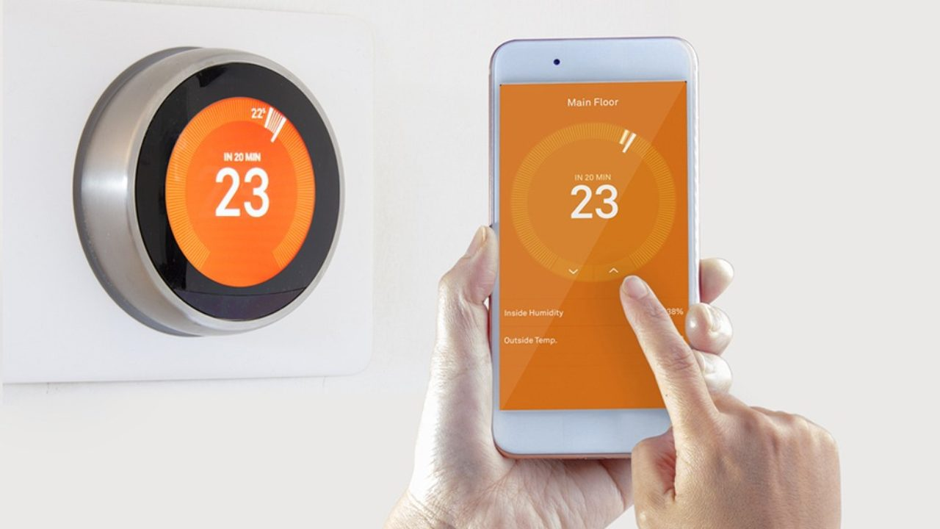
The Nest Thermostat
Image source: HelloTech (2020). Retrieved from https://www.hellotech.com/blog/google-nest-hvac-alerts-home-report
Notes:
Nest made our thermostat smarter by adapting to our usage power

Slide 13
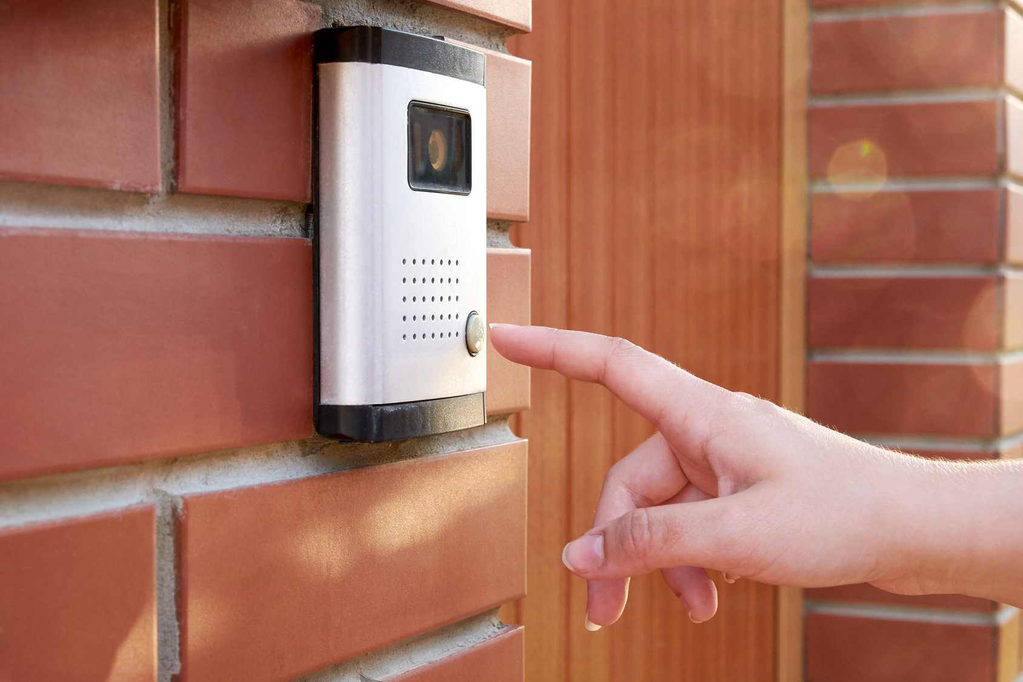
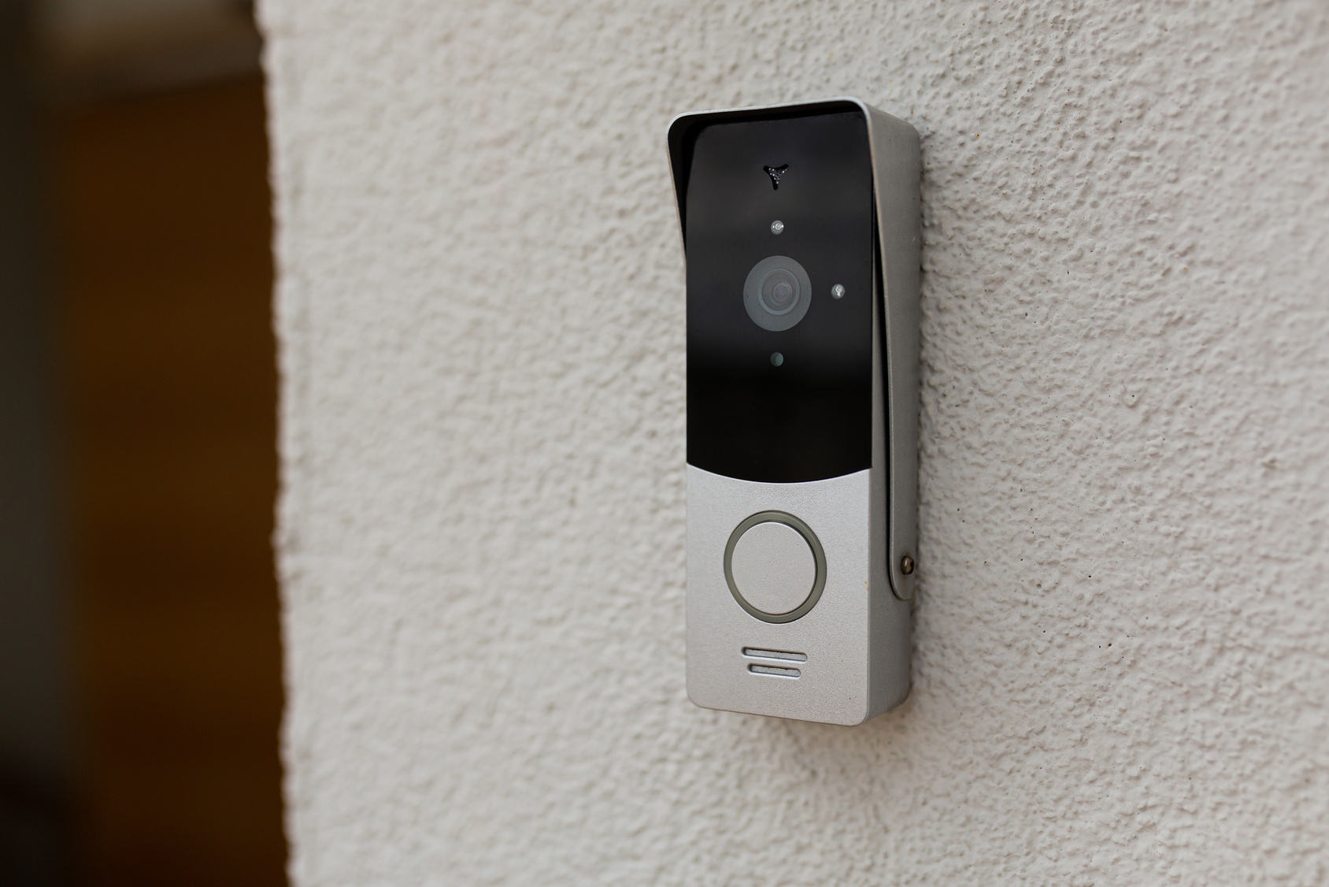

Camera Doorbells
Notes:
Nest made our thermostat smarter by adapting to our usage power

Slide 14
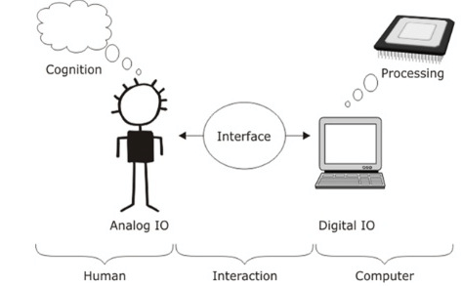
What is Human-Computer Interaction?
Image source: Lanc Zdenek (2015). HCI Basics. Retrieved from: http://www.slideshare.net/ZdenekLanc/hci-
basics?qid=058866e6-c87a-47fa-b57c-093ced4006af&v=&b=&from_search=20

Slide 15
The multidisciplinary field of HCI
Psychology
Sociology
Ethnography
Engineering
Computer science
-Design-
Notes:
From the reading: “HCI academic programs train many different types of professionals: user experience designers, interaction designers, user interface designers, application designers, usability engineers, user interface developers, application developers, technical communicators/online information designers, and more.”
https://www.interaction-design.org/literature/book/the-encyclopedia-of-human-computer-interaction-2nd-ed/human-computer-interaction-brief-intro
Human Factors/cognitive sciences: simple, useful & accessible
Design/Marketing: people who use the system should come first, UX ensures pleasant

Slide 16
The multidisciplinary field of HCI
Psychology
Sociology
Ethnography
Engineering
Computer science
HCI-
-Design-

Slide 17

What is Human-Computer Interaction?
“Human-computer interaction (HCI) is a multidisciplinary field of study focusing on the design of computer technology and, in particular, the interaction between humans (the users) and computers.” - Interaction Design Foundation (n.d.).
Interaction Design Foundation (n.d.). Human-Computer Interaction (HCI). Retrieved from
https://www.interaction-design.org/literature/topics/human-computer-interaction
Notes:
As computers evolve, the goal of HCI also evolves.
to make computer-based systems easier to use and more effective for people and organizations.
Bring the digital world into a physical space
In Virtual Reality (VR), the goal is to bring humans into a virtual world
In brain computer interfaces by removing the device (whether a mouse, a keyboard, a joystick, a sensor, etc.) the command is directly decoding from our brain, a whole new way of interaction between human and machine

Slide 18
History of HCI

Slide 19
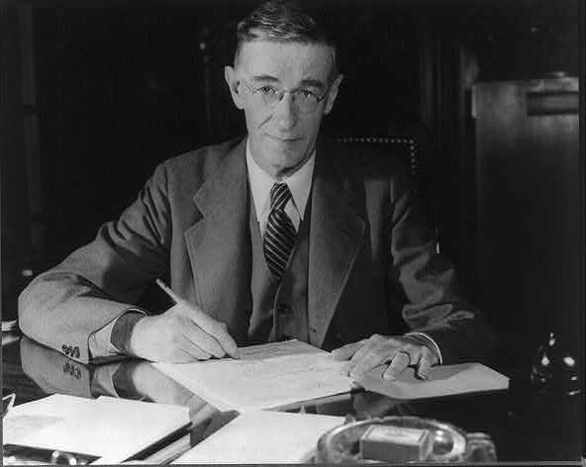
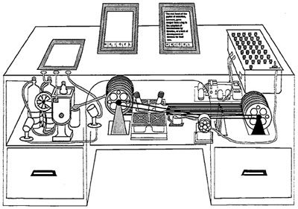
Vannevar Bush As We May Think The Atlantic Monthly 1945
Memex
Notes:
WWII is ending
Capturing, Storing, Retrieving, Sharing Information
Interactive!
Human-Centered
Founds NSF/DARPA
- was Fred Terman’s advisor
- Sets up the notion of Gov’t funding (NSF/DARPA)
- and of University research at scale as forming the leading edge of applied research
Memex device
– Can store all Can store all records/articles/communications records/articles/communications
– Large memory Large memory – Items retrieved by indexing, keywords, cross Items retrieved by indexing, keywords, cross references references
– Can make a trail of links through material Can make a trail of links through material – etc.
Envisioned as microfilm, not computer Envisioned as microfilm, not computer

Slide 20
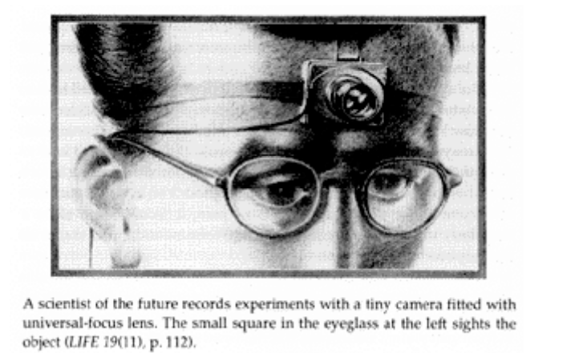
Vannevar Bush As We May Think The Atlantic Monthly 1945
Notes:
WWII is ending
Capturing, Storing, Retrieving, Sharing Information
Interactive!
Human-Centered
Founds NSF/DARPA
- was Fred Terman’s advisor
- Sets up the notion of Gov’t funding (NSF/DARPA)
- and of University research at scale as forming the leading edge of applied research
Memex device
– Can store all Can store all records/articles/communications records/articles/communications
– Large memory Large memory – Items retrieved by indexing, keywords, cross Items retrieved by indexing, keywords, cross references references
– Can make a trail of links through material Can make a trail of links through material – etc.
Envisioned as microfilm, not computer Envisioned as microfilm, not computer

Slide 21

Digital Computing
Notes:
“was the first large-scale, electronic, digital computer capable of being reprogrammed to solve a full range of computing problems”
Unveiled on Feb 14, 1946. Designed by John Mauchly and J. Presper Eckert.
ENIAC was massive compared to modern PC standards. It contained 17,468 vacuum tubes, 7,200 crystal diodes, 1,500 relays, 70,000 resistors, 10,000 capacitors and around 5 million hand-soldered joints. It weighed 30 short tons (27 t), was roughly 8.5 feet (2.6 m) by 3 feet (0.9 m) by 80 feet (26 m), took up 680 square feet (67.6 m²), and consumed 150 kW of power. Input was possible from an IBM card reader, while an IBM card punch was used for output.

Slide 22
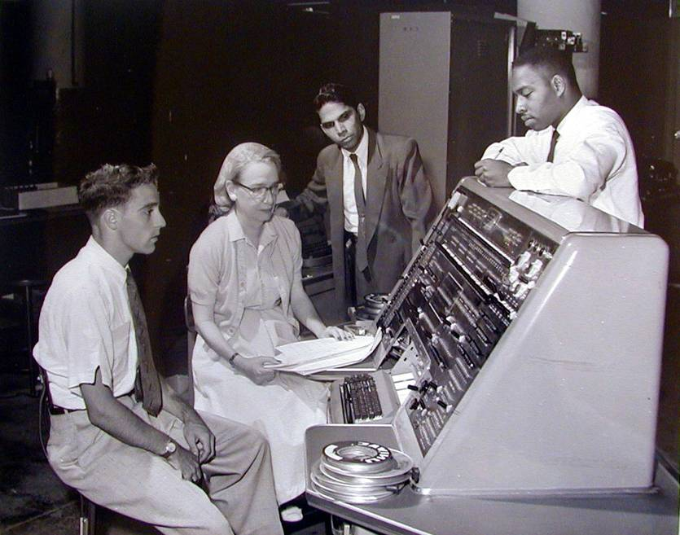
Compilers
Notes:
Now, this idea of creating tools to empower users has a long and storied history, beginning with Grace Hopper’s invention in the early 1950s of the first compiler. What’s inspirational for me is that she conceptualized how improved tools could provide a much wider audience with access to computation.
In the intervening years, good programming environments for the desktop and web enabled legions of developers to create the content that helped put a PC on every desk, and the goal of my group’s research is to enable an analogous success for ubiquitous computing. Specifically, our interest lies in the move from tools for technology experts toward tools for domain experts, designers.

Slide 23
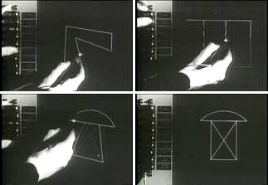
Graphical UI
Notes:
Licklider and Project MAC lead to … Sutherland’s Sketchpad! Initiated both graphics & HCI in one fell swoop.
Was also Alan Kay’s advisor.

Slide 24
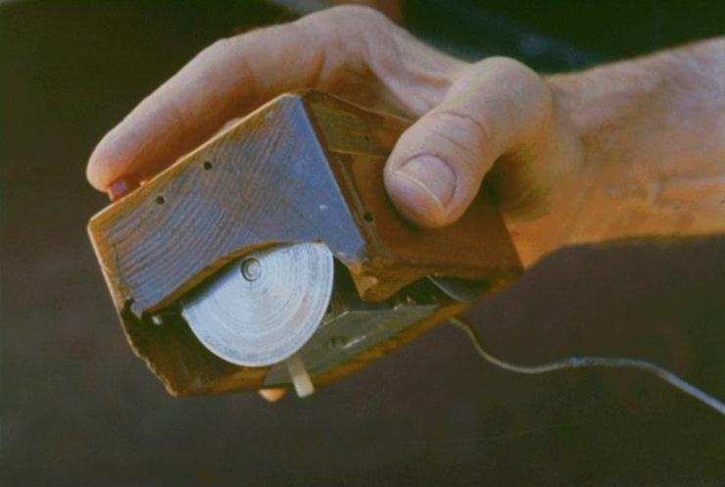
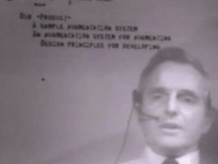
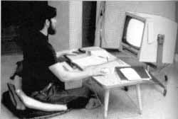
Mouse, Hypertext
Notes:
Influenced by Bush, @SRI (then part of Stanford)
- Hypertext
- Mouse – did informal testing, tried multiple versions
- Fall Joint Computer Conference

Slide 25
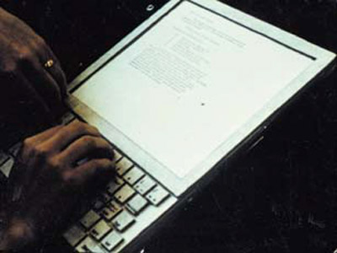
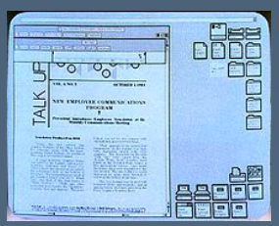
Xerox PARC: Alto
Alan Kay’s Dynabook
Notes:
Alan Kay gets his PhD at Utah, working with Ivan Sutherland.
Spends two years at SAIL, then leaves for newly created PARC, headed by Bob Taylor.
Prototype of Dynabook

Slide 26
Why we learn history of HCI?

Slide 27
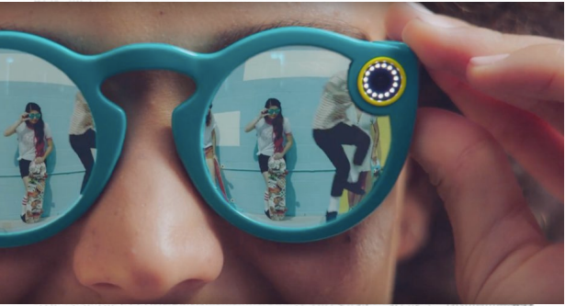
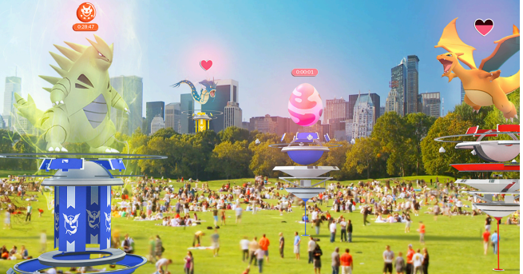
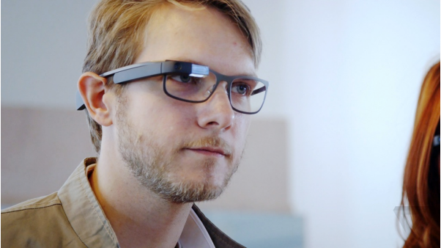
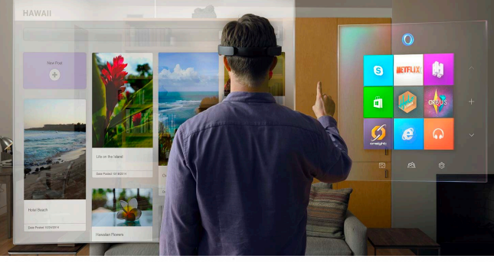

Slide 28
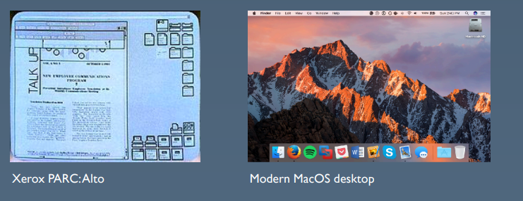

Slide 29
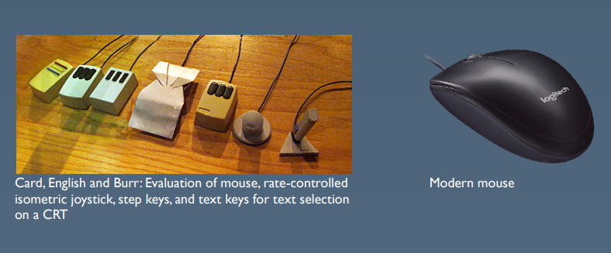

Slide 30
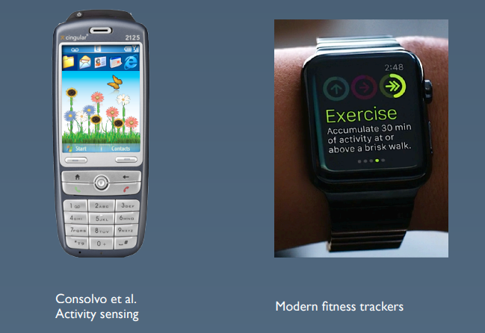

Slide 31
The multidisciplinary field of HCI
Psychology
Sociology
Ethnography
Engineering
Computer science
-Design-

Slide 32
Group Formation

